Slide 1

COMP 3962
Cloud Computing Platforms
Lab 4

Slide 2



Agenda
Load balancing & load balancer
AWS Elastic Load balancers

Slide 3
Load balancing
Functionalities:
  Efficiently distributes incoming network traffic(client requests) across a group of backend servers, also known as a server farm or server pool.
  Ensures high availability and reliability by sending requests only to servers that are online
  Provides the flexibility to add or subtract servers as demand dictates
Modern high‑traffic websites must serve hundreds of thousands, if not millions, of concurrent requests from users or clients and return the correct text, images, video, or application data, all in a fast and reliable manner.

Slide 4
Load balancer
It acts as the “traffic cop” sitting in front of your servers and routing client requests across all servers capable of fulfilling those requests in a manner that maximizes speed and capacity utilization and ensures that no one server is overworked, which could degrade performance.
If a single server goes down, the load balancer redirects traffic to the remaining online servers.
When a new server is added to the server group, the load balancer automatically starts to send requests to it.

Slide 5
Common Algorithms
Client side random
Round Robin
Weighted Round Robin
Random
Source IP hash
URL hash
Least traffic, weighted least traffic
Least latency

Slide 6

Hardware V.S. software

Slide 7
AWS Load Balancer
Notes:
https://www.linkedin.com/learning/aws-certified-solutions-architect-associate-saa-c02-6-auto-scaling-and-virtual-network-services/load-balancer-concepts

Slide 8
How it works
Elastic Load Balancing (ELB) automatically distributes incoming application traffic across multiple targets and virtual appliances in one or more Availability Zones (AZs).

Slide 9

Classic Load Balancer
Old Generation
Will get retired soon

Slide 10
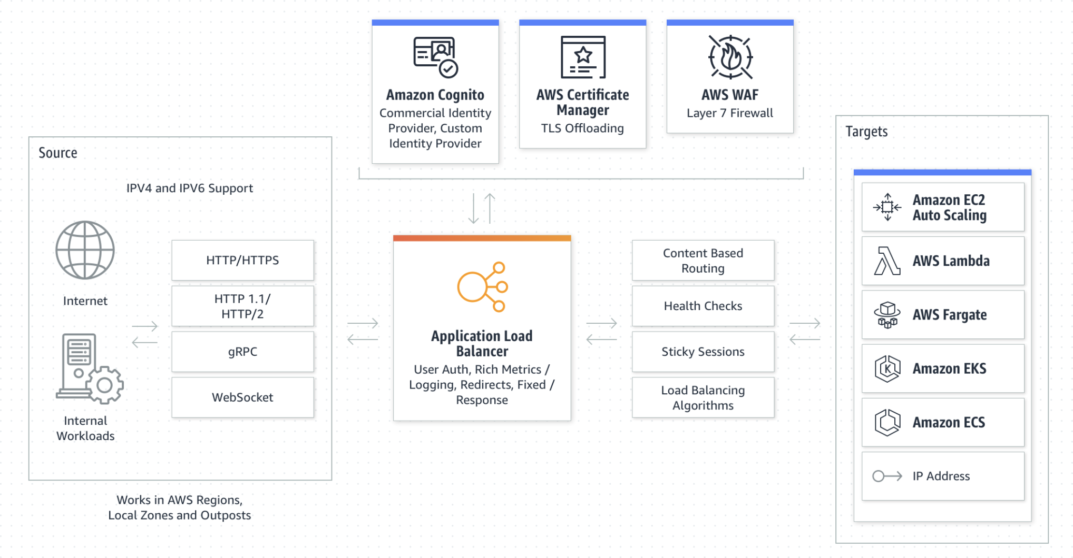
New Generation:
(1) Application Load Balancer

Slide 11
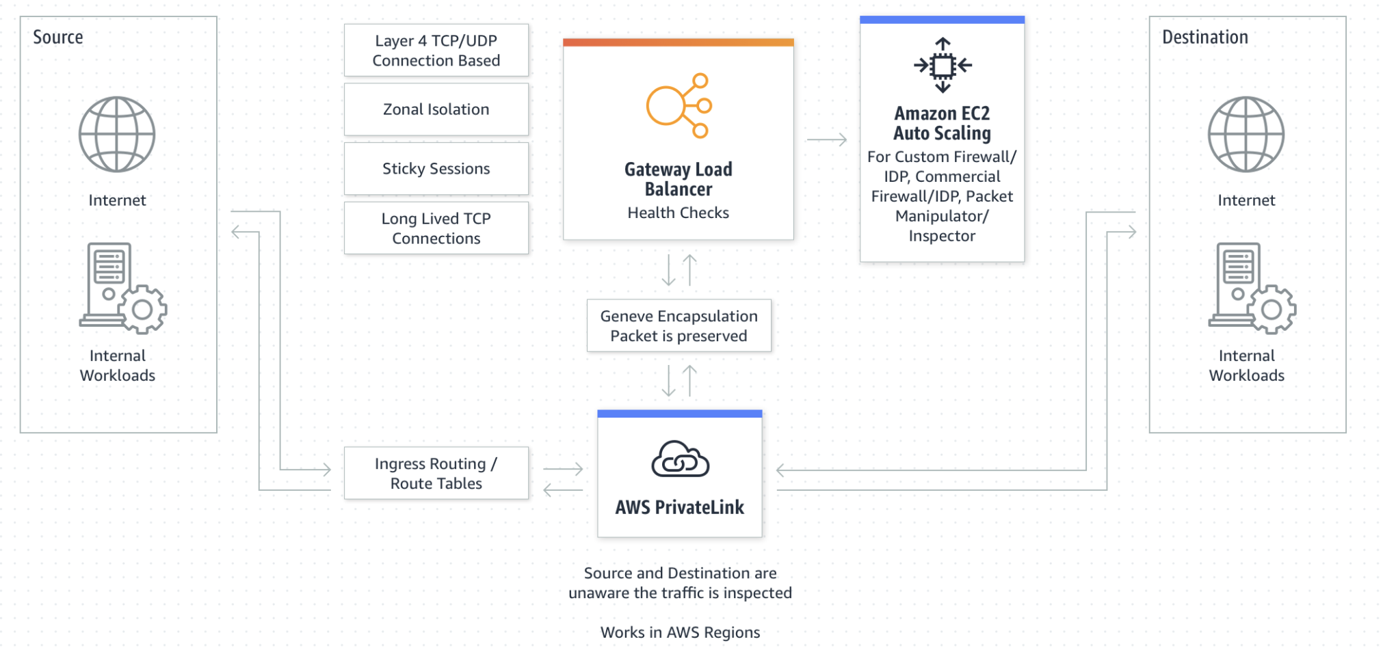
New Generation: (2) Gateway Load Balancer

Slide 12
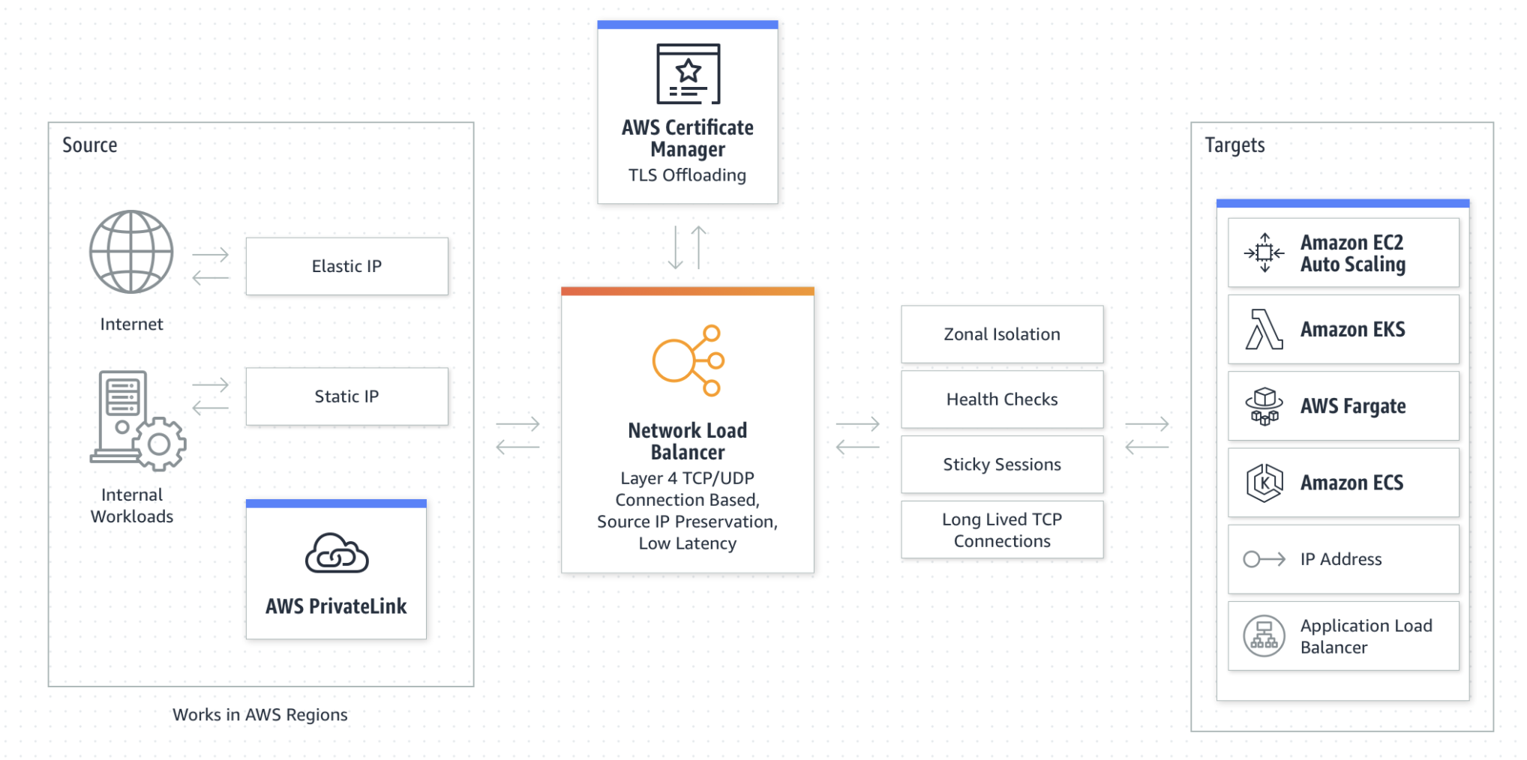
New Generation:
(3) Network Load Balancer

Slide 13
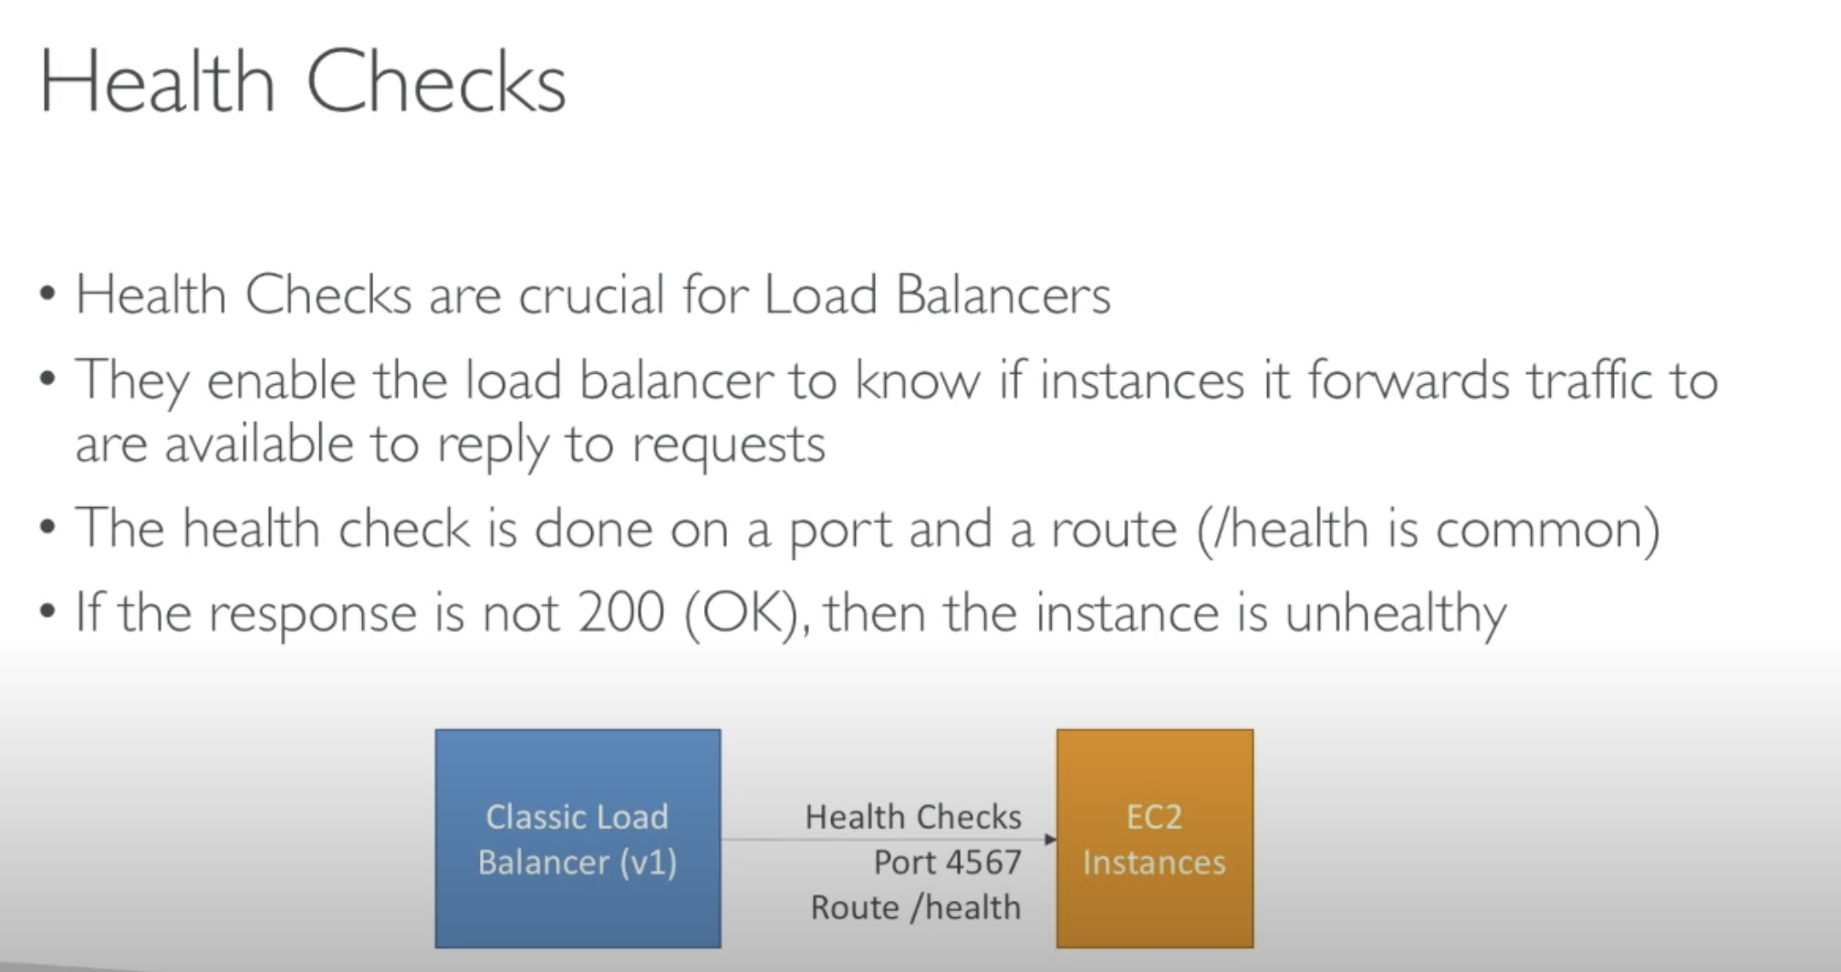

Slide 14

Lab Time

